Slide 1
Next Generation Interactive Query in ASG
Rex Xiong (熊鹏)
Microsoft ASG Shared Data

Slide 2
About Us
ASG: Application and Services Group
Shared Data
Shared Data Platform
Data Mining
Analysis and Experimentation

Slide 3



Query Scenario
Query Latency
Data Size

Slide 4







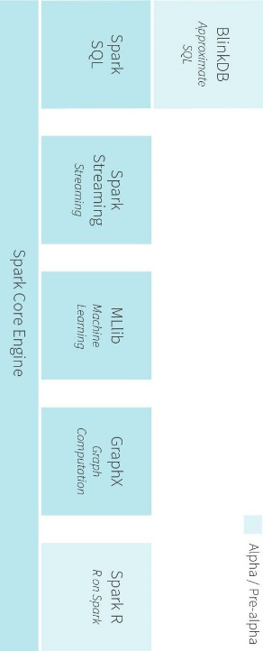



Experimental interactive analytics in ASG
Data
Data Products
Unified platform
Interactive analytics
Intelligence
Better Digital Experiences
Avocado
Analyst
Dual users
Transform Compute
Event Processing
Data Streams
Spark Streaming Receiver
Zeppelin Notebooks
“Glance”
Clients
Synchronous
experience
“Analyze”
Data Ingest
“Office”
“Debug”
Services
Transform Compute
Store
Data Sets
Data Transportation
HDFS
“Mine”
“Bing”
Simple query
Query language
Asynchronous
experience

Slide 5
Goal
Run Spark as a Service
Copy data from Cosmos to HDFS easily
Provide great interactive query and visualization experience

Slide 6
Architecture
Zeppelin Web UI
Rover
(Drag & Drop BI tool with Hive Code Gen)
Avocado
(Hive Query + Schedule Task)
Zeppelin Server
Spark Hive Thrift Server
Job FrontEnd Web API
ZooKeeper
Job Manager
MetastoreDB
Hive Loader
Zodiac (Mesos) Cluster/HDFS
Spark Driver Host Pool
Cosmos Storage
Purple blocks are Microsoft components

Slide 7
Cosmos -> HDFS

Slide 8
Hive Loader

Slide 9
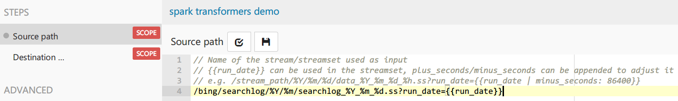
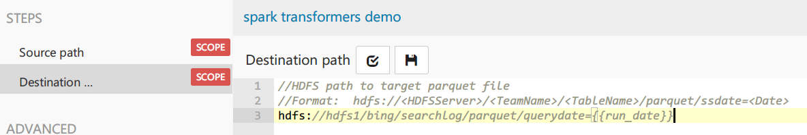
User Experience in Avocado Task

Slide 10
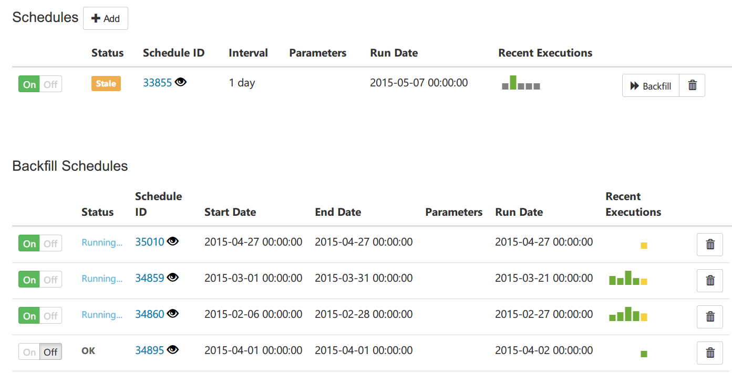
User Experience in Avocado Task (Cont.)

Slide 11
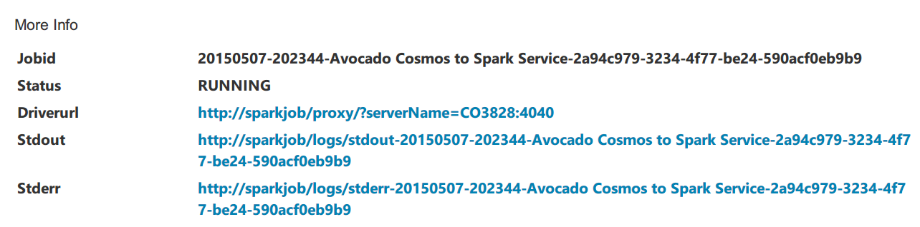
User Experience in Avocado Task (Cont.)

Slide 12
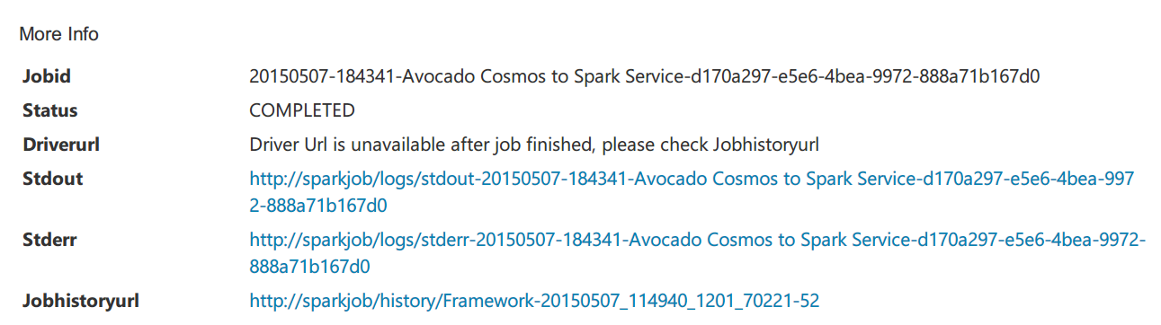
User Experience in Avocado Task (Cont.)

Slide 13
Use Cases

Slide 14
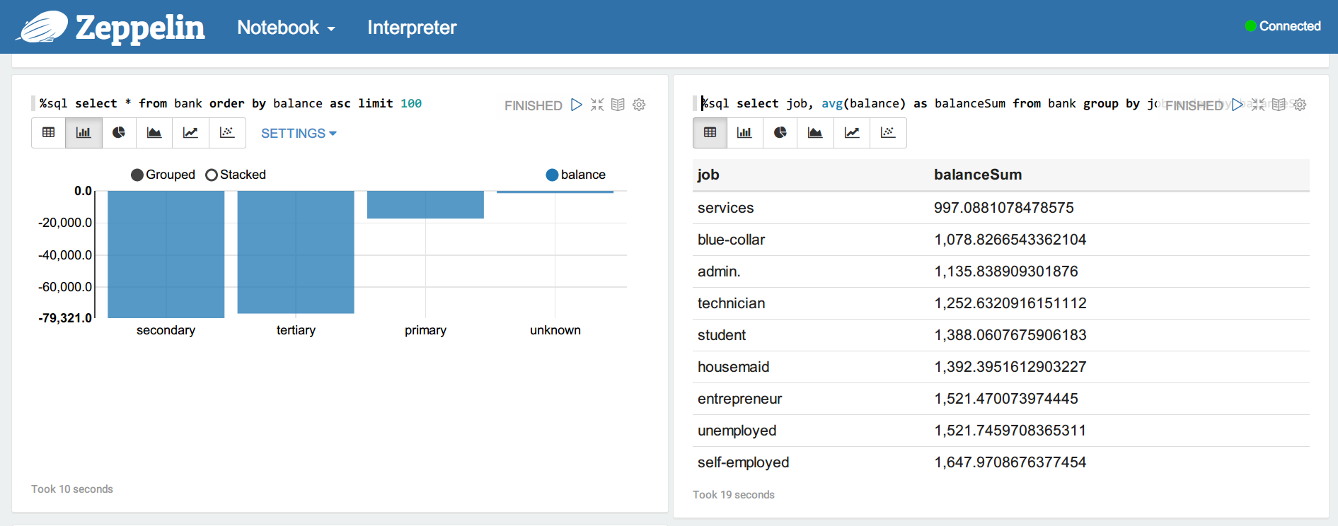
Run Ad-Hoc Query in Zeppelin

Slide 15
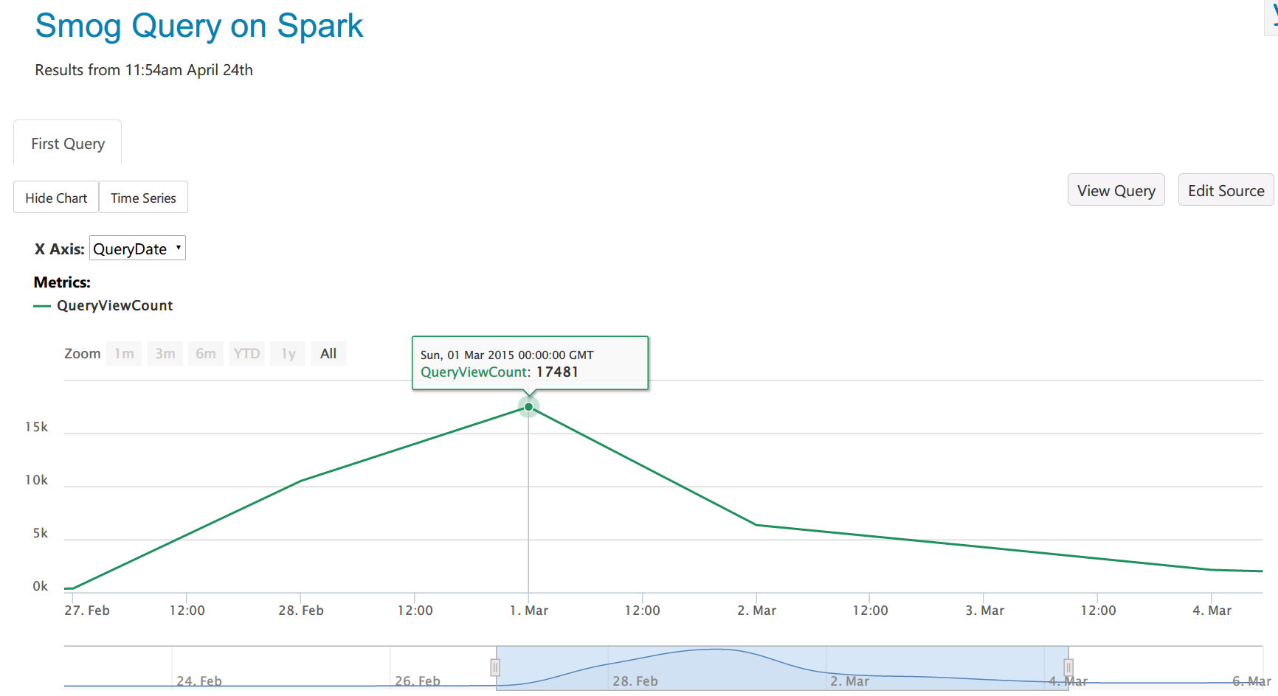
Build Advanced Report in Avocado
Count ‘雾霾’ in Bing search keywords
(2/28 <穹顶之下>)

Slide 16
Trouble Shooting Data Issue

Slide 17
Future Work

Slide 18
Future Work
Load balance for Hive Thrift Server
Create index when saving as Parquet
Tachyon

Slide 19
Thank You!
We’re Hiring~
pengx@Microsoft.com

